Slide 1
Masterclass 2

Slide 2
Who makes the best decisions?
Research from Cardiff University, published in The Conversation, 1 June 2022
Action-oriented people ‘focus on action. They are more decisive, flexible and likely to implement their intentions in the face of adversity.’
State-oriented people ‘focus on their emotional state. They are indecisive, often struggle to commit to their choices and abandon their commitments more frequently.’
Which group is likely to make more accurate decisions, i.e. decisions with a better outcome?

Slide 3
Why were we not better prepared for the pandemic?
Richard Horton, editor of The Lancet, has called the crisis ‘the greatest global science policy failure in a generation’
Bill Gates tweeted that ‘few governments will get an A-grade’ for their response to the challenge
In the UK alone, major exercises were held showing the impact of pandemics on the economy and society in 2016 (Operation Cygnus) and again in 2019.

Slide 4
Expected utility theory
Conventional economic theory argues that human nature means that we seek to maximise the return of any investment to ourselves
Expected utility = the value to us of any action
Expected utility theory assumes:
Unbounded rationality
Unbounded willpower
Unbounded selfishness

Slide 5
Behavioural economics
Behavioural economics assumes the opposite:
Bounded rationality
We make choices based on the information we have to hand
Instead of the best possible option we seek the best available option
Bounded willpower
Other factors may affect our will and thought processes
Heuristics, trial and error rather than calculation
Bounded selfishness
Most of us are capable of altruistic behaviour
Altruism is linked to pleasure-seeking behaviour (Oxytocin)

Slide 6
Consequences
We make decisions quickly and often on the basis of inadequate information – Henry Mintzberg, The Nature of Managerial Work
Asymmetries of information can lead to perceptions of risk which are not always accurate
Higher levels of risk mean we are reluctant to make decisions
Risk-information trade-off – e.g. risk of shutting down economy v. risk of transmission of coronavirus – what role did lack of information play?
When we lack information we fall back on past experience

Slide 7
Mass behaviour
The success of any institution depends on whether people are willing to join it (Elias Canetti, Crowds and Power)
Employees, customers, donors, etc
But why do people join institutions or movements? What motivates them?

Slide 8
Engaging with groups
Forms of engagement
Compliance; we join a group because we feel we should, but do not really subscribe to its values
Identification; we identify ourselves as members of the group, ‘people like us’, but our loyalty is likely to be tested if another option comes along
Internalisation; we join a group because we feel its values match our own, or we come to this realisation as time progresses
It is not always easy to know how engaged people are, as customers or employees, but internalisation is more likely to keep them fully engaged

Slide 9
‘Weapons of influence’
How to influence groups
Reciprocity; natural inclination to return favours
Consistency; people do not change their views without good reason, prefer security of the known
Social proof; people are more likely to do something if they see other people doing it
Authority; people tend to obey authority figures
Liking; people tend to imitate people they like
Scarcity; limiting resources tends to stimulate demand (limited editions and so on) (Robert Cialdini, Influence: Science and Practice)

Slide 10
Cognitive bias
Optimism bias
We believe what we want to believe because by taking an optimistic view we can explain away risk
Illusory superiority (Dunning-Kruger effect)
‘All of us have pockets of incompetence we don’t recognise’
Illusion of control (Langer effect)
We don’t know whether we have control or not
Losing control means loss of self-esteem
The measures we take to gain control often have the opposite effect (Triana, Lecturing Birds on Flying)
Normalcy bias (ostrich effect) – present at the beginning of the pandemic
Hofstadter’s Law
Things always take longer than we think they will
Inside view forecasting
We make comparisons with similar projects, not all available information
We make estimates in terms of what is desirable, not what is possible
Pessimism bias

Slide 11
Synergy, social loafing and groupthink
Synergy
Working with others enables us to achieve more than we can achieve working on our own – Adam Smith
Social loafing
When working with others, we don’t fully engage and therefore the whole ends up achieving less than the sum of its parts (Karau and Williams 1993)
Bystander effect
Groupthink
Desire for inter-group harmony takes precedence over rational decision making
Complicating factors: belief in own invulnerability, belief in own moral superiority
Examples: Bay of Pigs, 2016 US election, Russia-Ukraine war

Slide 12
Discussion
How do we correct for cognitive bias in the groups we lead?
On the part of ourselves?
On the part of our team members and the team as a group?
How do we overcome the problems of groupthink and social loafing, and achieve true synergy?

Slide 13
‘To think is easy. To act is hard. But the hardest thing in the world is to act in accordance with your thinking.’
(Johannes Wolfgang von Goethe)

Slide 14
Complex adaptive systems
Properties:
The ability to self-organise; local organisations emerge without conscious direction from the centre
Emergence, whereby the interaction of the parts produces something greater than the sum of those parts; synergy
Homeostasis, an internal balance achieved through self-regulation rather than any directed form of regulation
Communication and cooperation, taking place at all levels
A high degree of adaptive capacity, leading to high levels of resilience
Can be a variety of structures: cellular, networked, hierarchical, but more likely have features of all three

Slide 15
Six elements required to achieve this
The right people
The right culture
The right processes
The right resources
The right knowledge
The right leadership
A high-performing complex adaptive organisation requires a mix of all of these

Slide 16
People
Effective recruitment is crucial – get the right people into the right jobs
Infosys
Matching purpose to the required skills
Complementary skills and roles
Ensuring there is a diverse mix of people
Not just protected characteristics but backgrounds and lived experience
However, there is a strong correlation between the two – different backgrounds and experience often go hand in hand with diversity of ethnicity, gender, faith, disability and so on
Diversity if badly handled can go wrong, creating ingroups and lack of cohesion
Handled well, it is the cure for groupthink
And, don’t forget the moral argument

Slide 17
Culture
People create culture though the narratives they tell and the symbols they create
Group identity and sense of shared purpose
Can culture be ‘managed’? Perhaps not, but it can be influenced and reinforced
A strong culture requires the right people; how and who we recruit will influence that culture
Trust and psychological safety
Inclusion – ‘diversity means being invited to the party, inclusion means feeling comfortable enough to get up and dance’ (Vernā Morris)

Slide 18
Processes
The group needs to understand how it will work together, including any sub-groups or subordinate structures
Establish clear goals and make sure everyone understands them
Establish the nature of the task
Establish the skills required to achieve that task
The group needs to understand what role each group member has
Match group members to the to the required skills
The group needs to understand how it will interact with other groups and the outside world
Break down silos and be open to outside influences
It is important to get these processes right before the group embarks on a strategy

Slide 19
Tasks and jobs
Interdependent tasks – tasks which require team members to work together
Independent tasks – tasks which team members can complete alone
Additive tasks – tasks where the team work together to create something greater than the sum of the parts
Disjunctive tasks – tasks where there is one official solution, so the team is reliant on the team member(s) best capable of finding that solution
Conjunctive tasks – tasks where everyone works towards the same goal, so productivity will be limited by less competent members (Steiner 1972)
According to Steiner, ‘actual group productivity = potential productivity – process loss’

Slide 20
Job Characteristics Approach
Vertical Loading –designed to enhance autonomy, task identity, task significance, and skill variety by increasing the number of tasks and providing greater levels of control over how those tasks are completed.
Task Combination – By combining tasks into larger units of work and responsibility, task identity may be improved.
Natural Work Units – A form of task combination that represents a logical body of work and responsibility that may enhance both task significance and task identity.
Establishing Client Relationships – Designs interactions between employees and customers, both internal and external, to enhance task identity, feedback, and task significance. This is accomplished by improving the visibility of beneficial effects on customers.
Feedback – By designing open feedback channels, this intervention attempts to increase the amount and value of feedback received.

Slide 21
Resources
Contrary to popular belief, the best resourced teams are not always the most successful
Just-in-time, kanban, jugaad (frugal innovation) – asymmetric warfare
However, there are limits to what can be done with little or no resources - Stakhanov

Slide 22
Knowledge and communication
Knowledge is the lifeblood of the organisation
‘In the future, the most important single source of competitive advantage will be the ability to learn’ (Arie de Geus, The Living Company)
High-performing organisations share knowledge easily and have constant feedback loops in place to ensure complex organisations function (Nonaka and Takeuchi, The Knowledge-Creating Company)
Three stages of Design thinking (IDEO, designthinking.ideo.com):
Empathy – how we view the world around us generates ideas
Ideation – sifting and sorting the ideas to improve them and get rid of impractical ones
Experimentation – further shaping of ideas to make them tangible

Slide 23
Barriers to knowledge
Poor communications systems
Poor knowledge storage and repository systems – McKinsey
Lack of experience and prior knowledge to make sense of new knowledge
Cognitive bias – new knowledge often makes us feel uncomfortable (Gruenfeld et al, 2000)
‘Sojourners’ often have more success exporting ideas from their own organisation than bringing new ideas back in

Slide 24
The leader watches and listens…
And also, the leader tells stories
The leader engages with people
The leader supports and symbolises the culture – walking the walk
The leader oils the wheels of the processes, mending them when they are damaged, replacing them when they are broken
The leader procures resources where necessary
The leader ensures everyone shares resources

Slide 25
Story telling
Civilisation is built on stories – ancient myths and legends, Scheherezade
We tell stories and listen to stories in order to make sense of things
Sometimes we create stories even when no story appears to be there
If we don’t tell our story, someone else will tell it for us

Slide 26
Engaging people
Good narratives engage people and make them part of the story
Reader-response theory: the purpose of a narrative is to stimulate a response in the audience
Contradicts the theory of the ‘received narrative’
Engagement: the sense of being part of something, satisfying the needs for belongingness and self-esteem
Readers and film watchers cluster around certain story-tellers, and even engage in their own narratives
Jane Austen, Harry Potter, Game of Thrones
Companies do this too: Coca-Cola, Tata, Lego

Slide 27
Stories and the brain
Material that is presented in story form is more likely to remain in the memory, as this is how the brain makes sense of things
Memory is reconstructed storytelling. We remember things in ways that make sense to us.
Research by Wallintin et al. (2011) showed that narratives associated with intense emotion led to increased heart rate and altered brain activity
True of music also – Josef Haydn
Driver behaviour changes depending on what music they are listening to
Recently we have learned much more about the neuroscience behind storytelling
https://www.youtube.com/watch?v=Nj-hdQMa3uA

Slide 28
Discussion
So, how do we do apply story-telling to leadership?
What stories do we need to tell to recruit the right people?
What stories do we need to tell to create a strong and inclusive culture?
What stories do we need to tell to have efficient and effective processes?
What stories do we need to tell to coordinate resources?
What stories do we need to tell to encourage communication and knowledge sharing?
What stories do we need to tell to be an effective leader?

Slide 29
Leadership paradoxes
Leadership is full of paradoxes, seeming conflicting statements that cannot be resolved
Paradoxes are not a problem that can be solved. They are something we have to live with and learn to work around
Paradox of right and good – Somali convoy example
Paradox of I and we
Paradox of then and now
Paradox of courage and self-interest
Paradox of need and want

Slide 30
What is governance?
Ensuring that the organisation is governed in the best interests of its stakeholders
Question of which stakeholders, if any, get priority
Ensuring that the organisation is governed within the rule of law
Ensure that the organisation has a strong and effective culture
Ensuring that resources, including money, are used in accordance with the organisation’s purpose
Ensuring that the organisation has a balanced view of risk
Ensuring that the organisation is sustainable over the long term

Slide 31
Who is responsible for governance?
Everyone, but the board of directors bears ultimate legal responsibility
Directors can be fined, disbarred from serving as directors, or even sent to prison if they fail in their duties of governance
Separation of ownership and control
Principal-agent problem

Slide 32
Board composition
Average size of UK boards 10.5 members; US boards tend to be larger
Boards will also have committees or sub-committee: audit, finance, remuneration, etc
CEO and senior directors (the executive)
Others typically include the finance director, operations director and others whose functions are important to governance
Independent directors (the non-executive)
Some will represent shareholders (question: are they really independent?)
Depending on the board constitution, shareholder representatives may have greater or lesser voting power depending on number of shares owned
Others will be appointed from outside the organisation

Slide 33
Board responsibilities
Ensuring legal compliance
Audit
Overseeing corporate strategy, setting strategic objectives, overseeing M&As
Ensuring the organisation has a strong and high-functioning culture
Assessing risk and maintaining the risk register
Succession planning, appointing (and dismissing) the CEO, advising on the composition of the senior executive team
Remuneration and reward for senior executives (and the board itself)
Guarding the board’s public reputation ensuring it operates in an ethical manner
Communication with shareholders and other stakeholders
Supporting and assisting the executive team, but at the same time, assessing the executive team for their competence and fitness for purpose

Slide 34
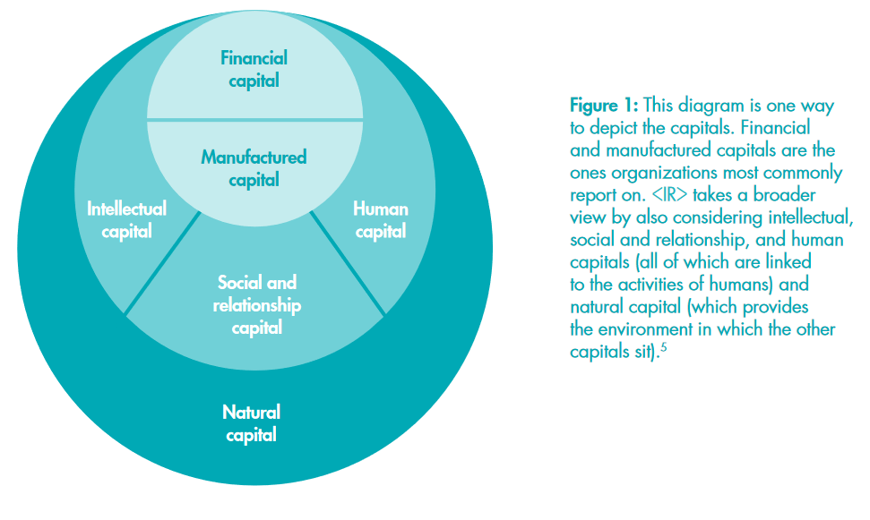
Integrated reporting – the six capitals

Slide 35
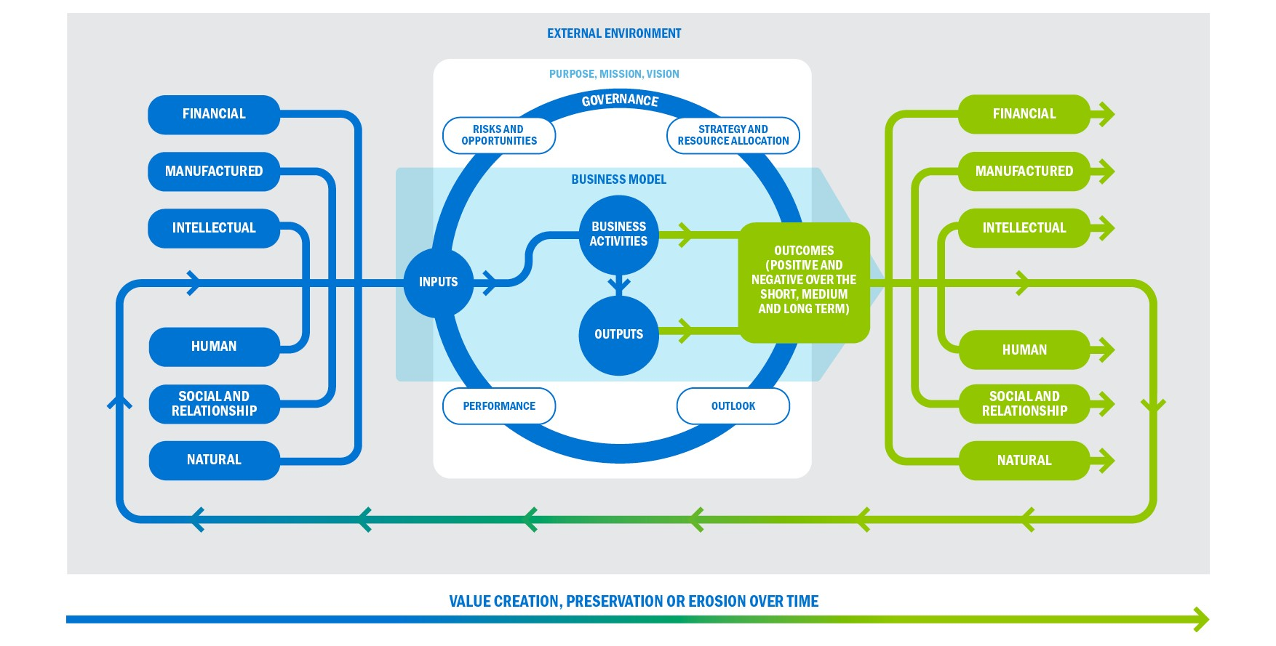
Integrated reporting – the next frontier

Slide 36
Metrics and narrative
‘Quantitative indicators, such as key performance indicators and in some cases, monetized metrics, can be very important in explaining an organization’s uses of, and effects on, various capitals.
Nonetheless, it is not an objective of <IR> to measure all the capitals or movements in them. Many uses of, and effects on, the capitals are best (and in some cases can only be) reported on in the form of narrative, rather than through metrics.’
(International Integrated Reporting Council)

Slide 37
Executive and non-executive responsibilities
The executive team is responsible for day-to-day operations. The non-executive directors do not interfere in these. Their job is oversight and scrutiny.
Another paradox: non-executive directors are responsible for the company, but they do not control it; they govern it.
But…where does the line between operational and strategic levels lie?
US boards do not get involved in strategy, European boards do
Unitary versus binary leadership
In the US and some other countries the CEO and chair can be the same person
Every board needs to set this line
And when, if ever, is it permissible to cross it?

Slide 38
‘A job for which no one is qualified’ (Financial Times)
‘The list of attributes required of the non-executive director is so long, precise and contradictory that there cannot be a single board member in the world that fully fits the bill. They need to be supportive, intelligent, interesting, well-rounded and funny, entrepreneurial, objective yet passionate, independent, curious, challenging and fit. They also need to have a financial background and real business experience, a strong moral compass, and be first-class all-rounders with specific industry skills.’
--Financial Times

Slide 39
Beyond board meetings
Board meetings are about a lot more than turning up to meetings and getting a free lunch.
My own experience:
Serving as temporary chair of the board
Serving on committees (finance and audit, safeguarding, business development, strategy, ethos)
Serving on task and finish groups (strategy, group cohesion)
Leading process to recruit new chair and new CEO
Leading process to develop emergency strategic goals during the pandemic
Chairing meetings of ethos committees and leads across a decentralised organisation
Devising a system of board evaluation and helping to implement it
Serving on working party overseeing merger with another organisation
Leading on the production of board papers on strategy and ethos
Conducting a formal investigation into allegations of misconduct by the CEO
Sitting on a disciplinary panel for a senior executive

Slide 40
Three basic functions
Stewardship – ensuring the organisation functions in accordance with legal frameworks and its own stated mission
Mentoring and support – advising the executive on the best way forward and bringing personal experience to bear
Resource provision – bringing personal networks into play to provide support for the organisation

Slide 41
The paradox of challenge and support
‘Simultaneously coach and referee’
Relationship with the executives must involve a degree of separation
As a non-executive director, I work with and support the executive team, but I also know my job is to discipline them if they do things wrong (yet another paradox)
Where is the balance between challenge and support?
This is often the greatest single source of tension on boards

Slide 42
The importance of independence
Independent non-executive directors are the backbone of the board (Gerry Brown, The Independent Director)
Independence of action, freedom to act
Independence of thought, do not simply accept what is said, triangulate and make own decisions
Independence of spirit, freedom to speak up and challenge in a respectful and diplomatic way
Don’t be afraid to be the only dissenter
Don’t be afraid to be unpopular

Slide 43
When the board fails, the consequences can be enormous
Loss of share value, damage to investors such as pension funds
Job losses with consequent social and pyschological damage
Knock-on job losses in related industries
Loss of tax revenues
Faulty or dangerous products
Damage to reputation
Psychological harm to employees and others
Damage to the environment
And of course…

Slide 44
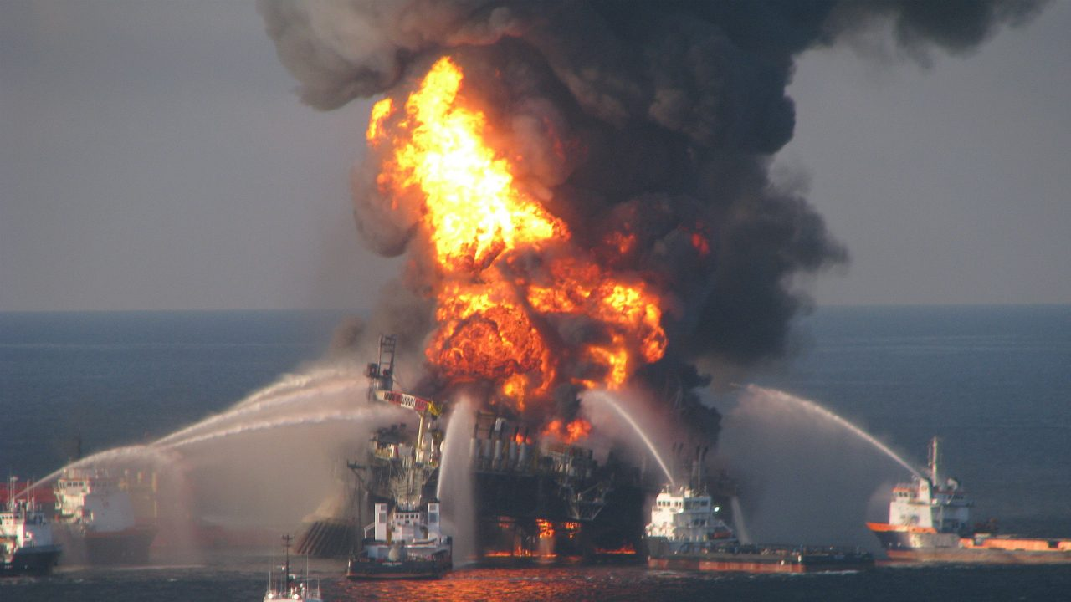

Slide 45
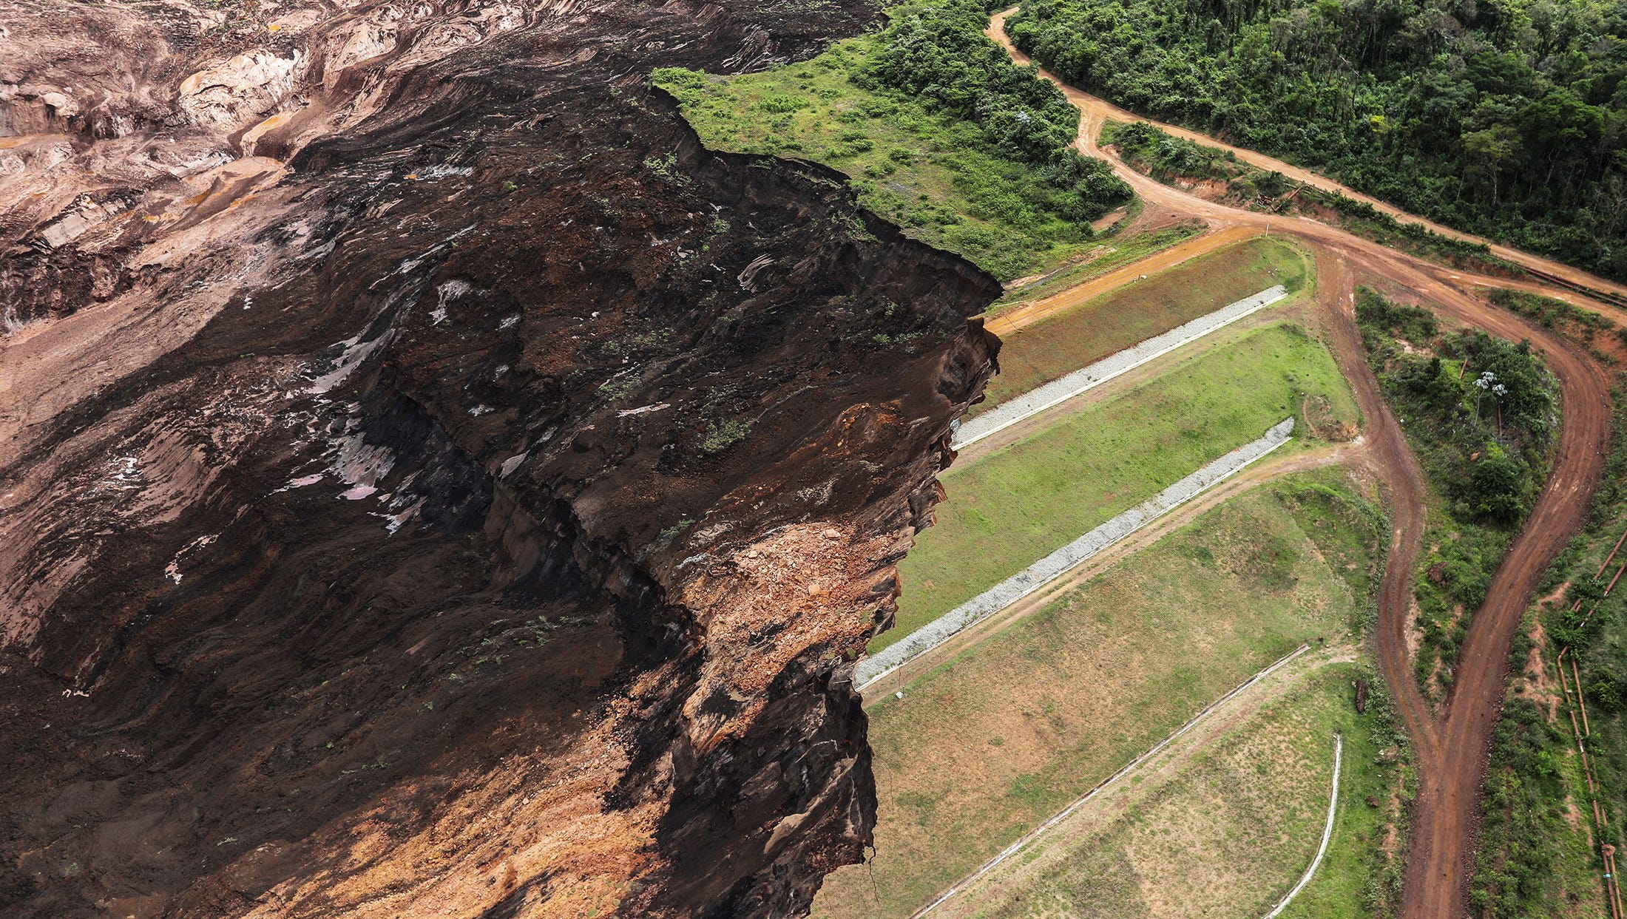

Slide 46
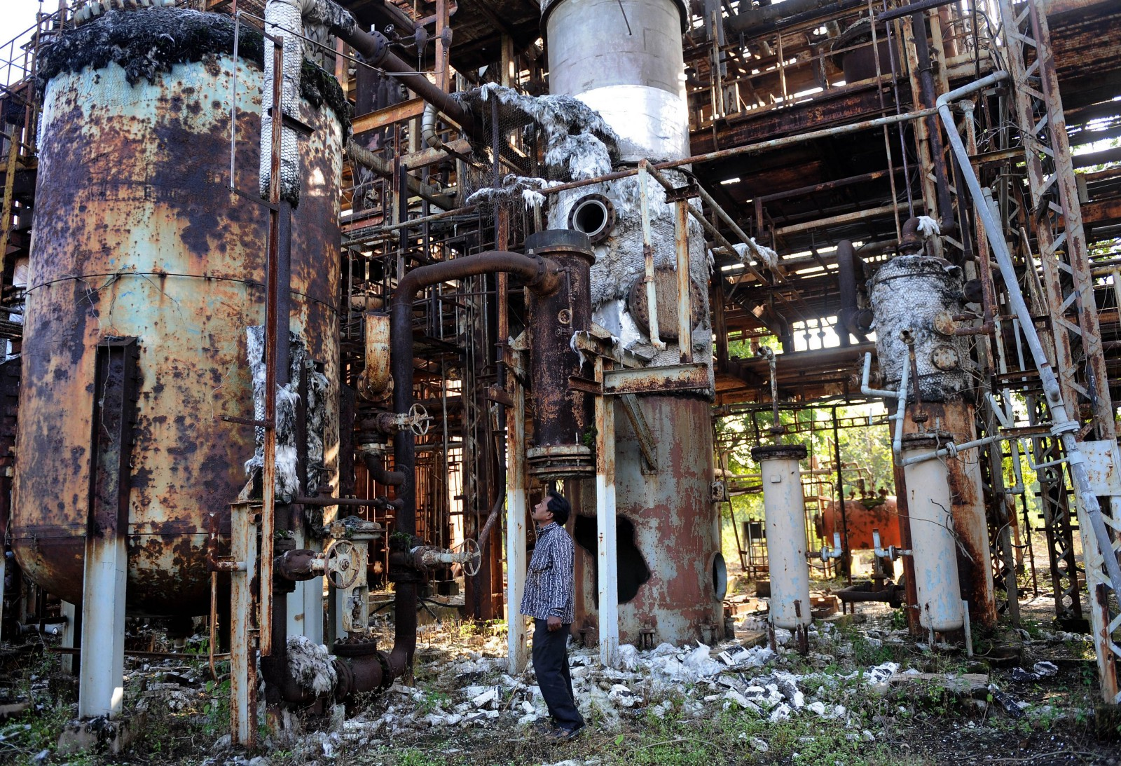

Slide 47
Discussion
You are independent non-executive board members of a food processing company. At 2 am, you are woken by a telephone call. The media are about to run a report that some of your products have been contaminated with listeriosis poisoning. Many people are already in hospital, and some are likely to die. An emergency board meeting has been called for 10 am.
What will you say at this board meeting? What questions will you ask? What responses will you expect to receive?
What will you do if the responses you receive are not forthcoming? How will you hold the company to account?

